Slide 1

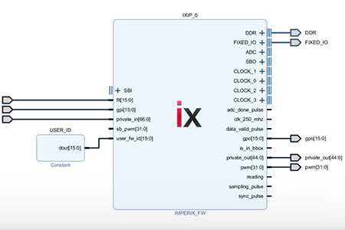
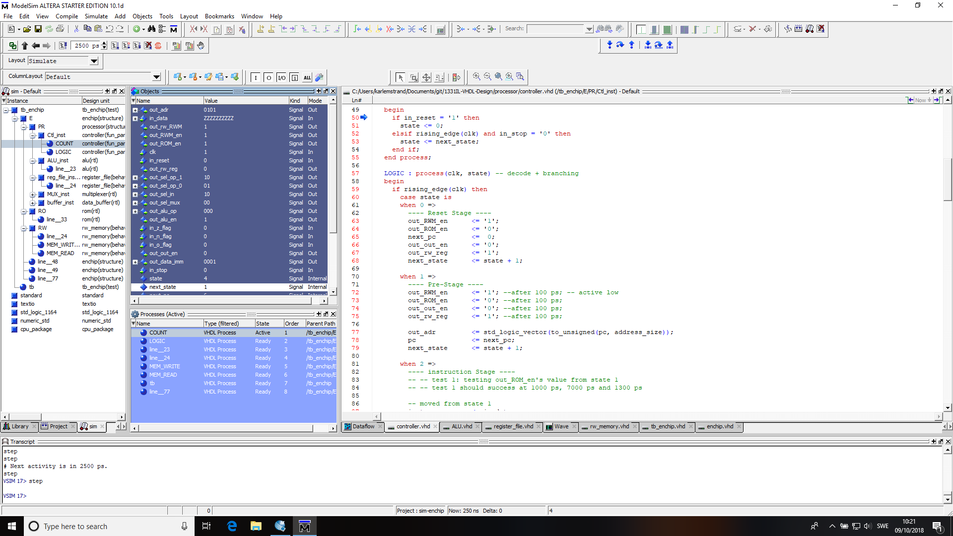

Slide 2


Slide 3
VHDL For FPGA
Design Flow
Design Entry
The circuit is specified using a Hardware Description Language e.g. VHDL, Verilog.
Functional Simulation
Also called behavioral simulation .
Here , we will only verify the logical operation of the circuit .
Stimuli is provided to the logic circuit , so we can verify the outputs behave as we expect
Physical Mapping
The inputs/outputs of our digital circuit are mapped to specific pins of the FPGA.
Timing Simulation
It simulates the circuit considering its timing behavior delays between inputs and outputs.
Implementation
A configuration file (‘ bitstream ’ file) is generated and then downloaded onto the FPGA configuration memory

Slide 4


VHDL For FPGA
Design Flow (VIVADO Software)
Synthesis:
The VHDL code is examined for syntax errors and warnings.
While your code should be free of syntax errors, watch out for warnings and critical warnings.
Simulate Behavioral Model:
We need to write a VHDL file called ‘testbench’ where we specify the stimuli to the logic circuit.
Implement Design:
(Translate + Map + Place & Route)
Generate Programming File :
Here, a configuration file or bitstream (.bit) is generated.
This file will configure the FPGA so that the logic circuit is implemented on it.
Configure Target Device: (Programming)
The bitstream file is written onto the FPGA configuration memory so that a digital circuit is materialized. At this stage, we can verify whether the hardware is actually working.

Slide 5
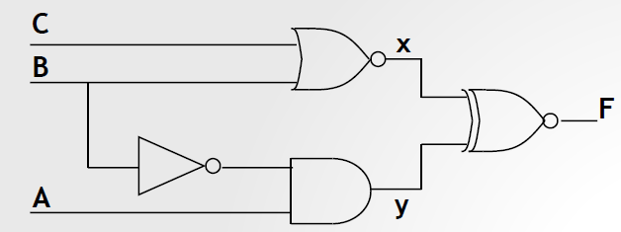

VHDL For FPGA
Logic Gates in VHDL
VHDL allows for the specification of Boolean functions based on the following gates: AND, OR, NOT, XOR, NAND, and NOR.
Write VHDL code to implement:
Note: In VHDL, A B C are inputs (IN), F is an output (OUT), and x and y are internal signals (signal).

Slide 6
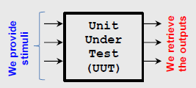
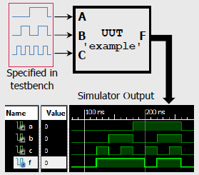
VHDL For FPGA
Testbench Generation

Slide 7
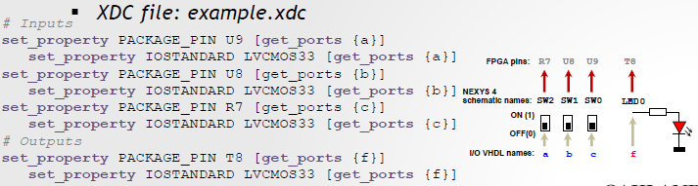
VHDL For FPGA
I/O Assignment
UCF file (Obsolete)
XDF file:
Here, we map the I/O’s of our circuit to physical FPGA pins.
Note: Pin names are case sensitive and must match the port names as specified in the VHDL entity

Slide 8
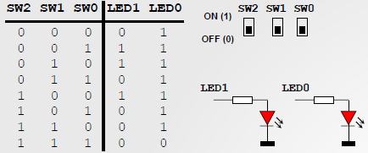

VHDL For FPGA
Mini-Project: Light Control
There are three available switches.
We want LED1 ON when only one of the switches is in the ON position.
And we want LED0 ON only when the three switches are in the ON position.

Slide 9
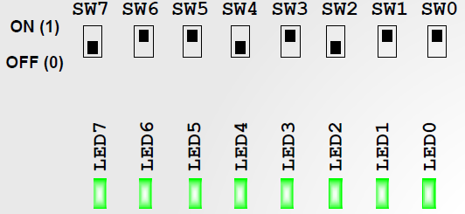
VHDL For FPGA
Mini-Project: Security Combination
A lock is opened only when a certain combination of switches exist : Switches: 01101011
The lock will be represented by 8 LEDs. Open Lock == All LEDS ON.

Slide 10
UNIT 2

Slide 11
VHDL For FPGA
UNIT II: CONCURRENT DESCRIPTION
‘with select’, ‘when else’ statements
Arithmetic expressions, integer type, type conversions.
Examples: multiplexor, LUT, decoder, tri-state buffer
In this description, the order of the statements is irrelevant: all the statements represent circuits that are working at the same time.
This type of description is well suited for combinatorial circuits.
The use of sentences with ‘and’, ‘or’, ‘ xor ’, nand ’, ‘nor’, xnor ’, and ‘not’ is a basic instance of the concurrent description. It is sometimes called ‘horizontal description’.
In Unit 4, the so called ‘structural description’ is just a generalization of the concurrent description.
Since we already know how to build circuits based on logic gates, we now present two concurrent assignment statements ( with select, when else ), which are far more powerful than the statements with logic gates when it comes to describe complex circuits.

Slide 12
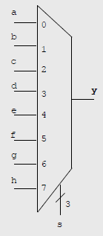
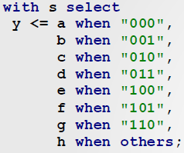
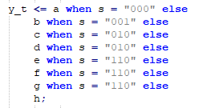
VHDL For FPGA
MUX 8-to-1:
Selected Signal Assignment (WITH – SELECT):
Selected Signal Assignment (WHEN – ELSE):

Slide 13
VHDL For FPGA
MUX 8-to-1:
Selected Signal Assignment (WITH – SELECT):
Selected Signal Assignment (WHEN – ELSE):

Slide 14
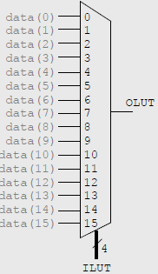
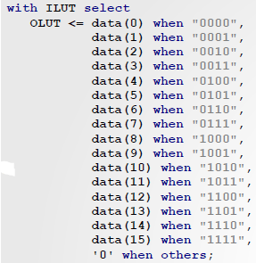
VHDL For FPGA
4-to-1 LUT:
Selected Signal Assignment (WITH – SELECT):
Selected Signal Assignment (WHEN – ELSE):

Slide 15
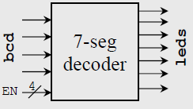
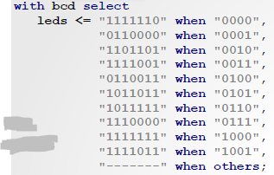
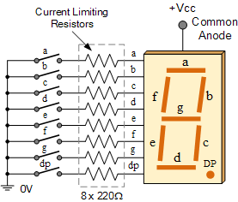
VHDL For FPGA
7-segment DECODER (outputs >= inputs)
Selected Signal Assignment (WITH – SELECT):
Selected Signal Assignment (WHEN – ELSE):

Slide 16
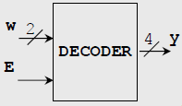
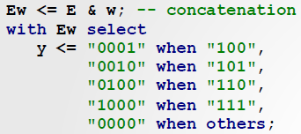
VHDL For FPGA
Decoder 2-to-4 with enable:
Selected Signal Assignment (WITH – SELECT):
Selected Signal Assignment (WHEN – ELSE):

Slide 17
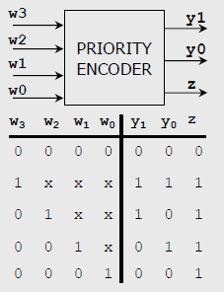
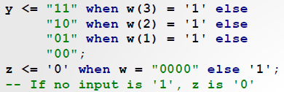
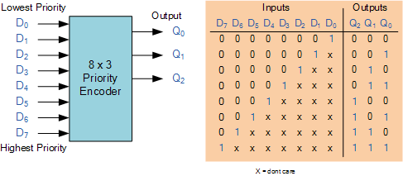
VHDL For FPGA
Priority Encoder 4-to-2
Selected Signal Assignment (WHEN – ELSE statement):
An “n-bit” binary encoder has 2^{n} input lines and n-bit output lines with common types that include 4-to-2, 8-to-3 and 16-to-4 line configurations.
Write Code for: Priority Encoder 8to3

Slide 18
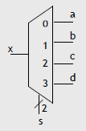
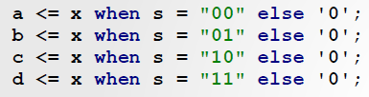
VHDL For FPGA
Demultiplexer
Selected Signal Assignment (WHEN – ELSE):
Note that the order of the statements is not relevant.
Write Code for: 1to8 DeMux

Slide 19
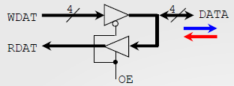
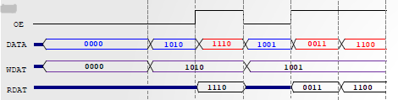
VHDL For FPGA
Bidirectional Port
Selected Signal Assignment (WHEN – ELSE):
To avoid data contention, make sure that DATA = Z when DATA is to be an output.

Slide 20


VHDL For FPGA
Tri-State Buffer
Selected Signal Assignment (WHEN – ELSE):

Slide 21

VHDL For FPGA
INTEGER Data Type
A signal of type ‘integer’ represents a binary number. But we do not specify the number of bits for the signal, only the range of decimal values (this can be very convenient).
Drawback: the datatype ‘integer’ does not allow access to the individual bits (unlike ‘std_logic_vector’)

Slide 22

VHDL For FPGA
Arithmetic Statements
We can use the operators +,-, and for rapid specification of arithmetic operations for integer numbers.
We can also use the comparison statements: >,<,=,/=,>=,<=.
ADD/SUBTRACT
+/- : The operands and the result must have the same bit width.
You must specify the representation for a,b as either (signed/unsigned)
“_unsigned” library: a-b: unsigned subtraction.
“_signed” library: a-b: signed (Two’s compliment) subtraction
Overflow not accounted for. Here, you might need to zero/sign extend the input operands.
Multiplier (fully combinational):
You can use the operator ‘*’. Make sure the output size is correct
Input Operators: a ( NA bits), b ( NB bits) :Output result: f ( NA+NB bits)
Operations:
You must select the representation (unsigned/signed) for the operands.

Slide 23

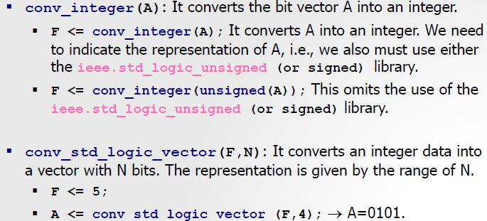
VHDL For FPGA
Arithmetic Statements
The library ieee.std_logic_arith.all lets us perform conversions from bit vector to binary and vice versa
Write Code for: 4 bit adder/subtracter - Combinational

Slide 24
UNIT 3
BEHAVIORAL DESCRIPTION
Asynchronous processes (decoder, mux, encoder, etc.): if-else , case, for-loop
Arithmetic expressions inside asynchronous processes

Slide 25
VHDL For FPGA
BEHAVIORAL DESCRIPTION (OR SEQUENTIAL)
In this design style , the circuit is described via a series of statements ( also called sequential statements ) that are executed one after other ; here the order is very important .
This feature is advantageous when it comes to implement sequential circuits . The sequential statements must be within a block of VHDL code called ”process”
The sequential code suits the description of sequential circuits very well . However , we can also describe combinatorial circuits with sequential statements
Here we will use the sequential description style to implement combinatorial circuits . In this instance , the block of VHDL code (‘process’) is called asynchronous process.

Slide 26
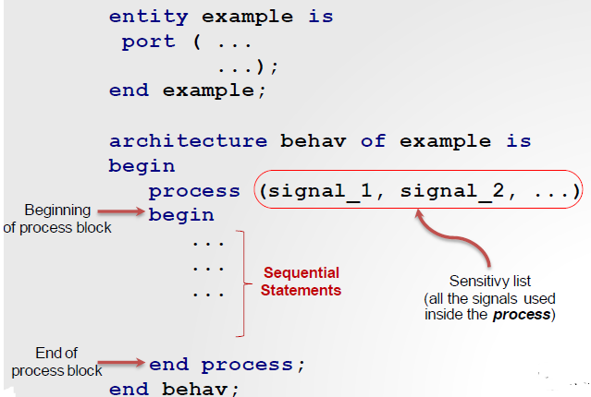
VHDL For FPGA
Asynchronous Processes
Implementation of combinatorial circuits with sequential statements
Below we show the syntax of a sequential description . Note that the ‘process’ statement denotes the sequential block.
It is a good coding practice to include all the signals used inside the process in the sensitivity list.
Process: Statements are ‘executed’ (the way the synthesizer reads it) one after the other.

Slide 27
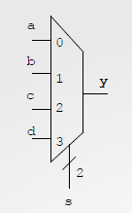
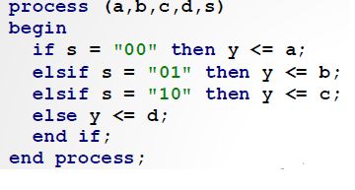
VHDL For FPGA
IF STATEMENT ( Simple Condition)
Example: 4-to-1 Multiplexor
Using the (IF – ELSEIF -ELSE):

Slide 28
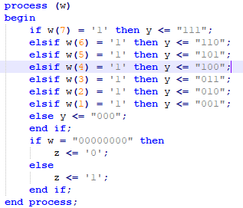
VHDL For FPGA
Priority Encoder 8-to-3
Using the (IF – ELSEIF -ELSE):

Slide 29
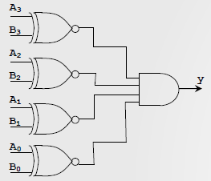
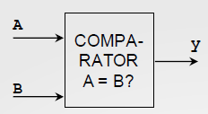
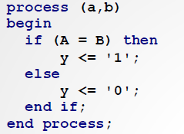

VHDL For FPGA
4-bit comparator
Using the (IF – ELSEIF -ELSE):
‘BAD DESIGN’:
4-bits comparator, but the ‘else’ is omitted:
If a ≠ b => y = ?
Since we did not specify what happens when a ≠ b, the synthesizer assumes that we want to keep the last value of ‘y’.
In the circuit, initially ‘y’ will be‘0’. But: If a = b y = ‘1’ forever. It is said that the output has an implicit memory since it ‘remembers’ the previous value of y. This results in a faulty comparator.

Slide 30
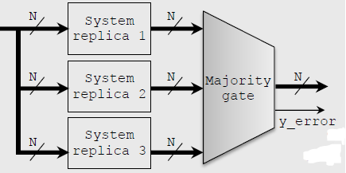
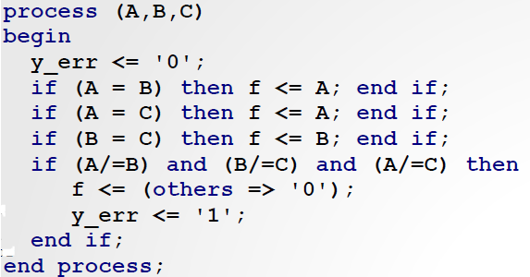
VHDL For FPGA
Majority Gate Example
Triple Modular Redundancy:
To improve reliability, a system is replicated three times. The 3 generated outputs go into a majority voting system (majority gate) to produce a single output.
If at least two replicas produce identical outputs → the majority gate selects that output. If the three replicas produce different results, the majority gate asserts an error flag (y_error = ‘1’)

Slide 31
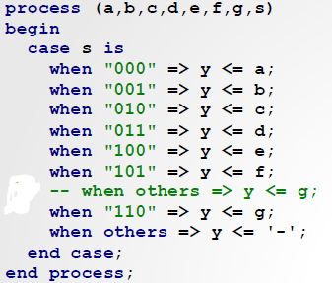

VHDL For FPGA
CASE STATEMENT
It is used in multi-decision cases when nested IF’s become complex.
All possible choices must be included (see the keyword when for every choice of the ‘selection signal’)
Last case: We must use when others (even if all the 0/1s, as std_logic has 9 possible values). This also avoids outputs with implicit memory
MUX 7-to-1
Note: y <= ‘-’ (don’t care). This allows the synthesizer to optimize the circuit.
If , however , we had used when others => y <= g The synthesizer would have assigned the value ‘g’ for the cases “110” and “111” (a slightly less optimal circuit

Slide 32
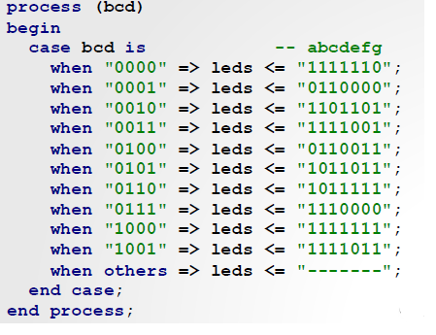
VHDL For FPGA
7-Segment Decoder: CASE STATEMENT
Using the (CASE IS WHEN):

Slide 33
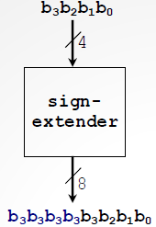
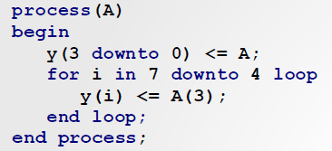
VHDL For FPGA
FOR LOOP STATEMENT
Very useful for sequential circuit description.
But, it can also be used to describe some combinatorial circuits.
Example: Sign extension (from 4 bits to 8 bits)

Slide 34

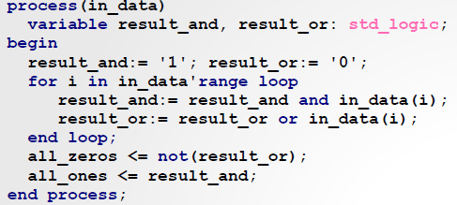

VHDL For FPGA
Ones/zeros detector
It detects whether the input contains only 0’s or only 1’s.
Input length: Parameter ‘N’.
This is a rare instance where using process for combinational circuits is the most efficient description
Variable inside a process: it helps to describe this circuit. Depending on the implementation, a ‘variable’ could be a wire.

Slide 35
UNIT 4
STRUCTURAL DESCRIPTION
Hierarchical design :port-map, for-generate, if-generate
Examples: Adder , multiplier , ALU, Look up Table
Introduction to Parametric Coding

Slide 36
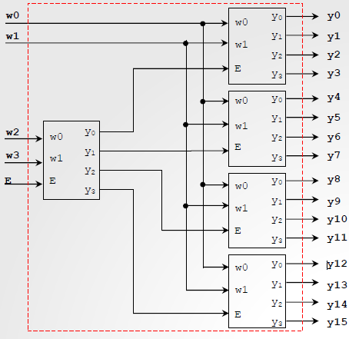
VHDL For FPGA
Structural Description
It is the generalization of the Concurrent Description.
The circuits are described via interconnection of its subcircuits. This subcircuits can be described in concurrent code and/or sequential code.
Example: 4-to-16 Decoder
We can describe this decoder in an structured way based on 2-to-4 decoders.
However, we can also describe the 4-to-16 decoder using the with-select statement.

Slide 37
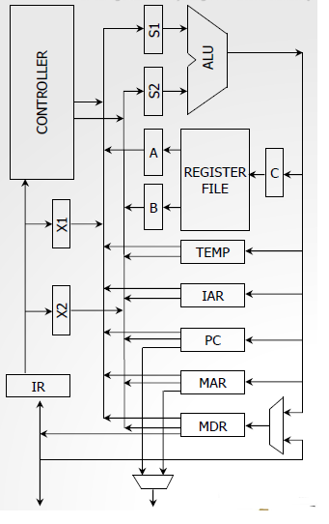
VHDL For FPGA
Structural Description
Example: DLX Processor
In this type of systems , it is best to describe each component first , then assemble them to make the large system
We do not need to see such large system to realize the importance of the Structural Description

Slide 38
VHDL For FPGA
Structural Description
Many systems can be described entirely in one single block: we can use the behavioral description , or concurrent statements (with select , when else)
However , it is advisable not to abuse of this technique since it makes :
the code less readable,
the circuit verification process more cumbersome, and
circuits improvements less evident
The structural description allows for a hierarchical design : we can ‘see ’ the entire circuit as the pieces it is made of, then identify critical points and/ or propose improvements on each piece.
It is always convenient to have basic building blocks from which we can build more complex circuits . This also allows building block ( or sub system ) to be re used in a different circuit

Slide 39
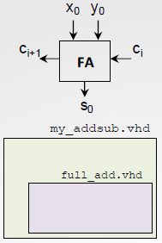
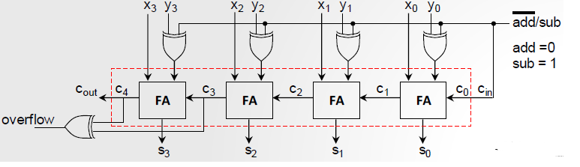
VHDL For FPGA
4-bit Adder/Subtracter (2’s Compliment)
The circuit can be described in one single block. However, it is best to describe the Full Adder as a block in a separate file (fulladd.vhd), then use as many full adders to build the 4-bit adder.
In order to use the file ‘fulladd.vhd’ into the top file , we need to declare it in the top file

Slide 40
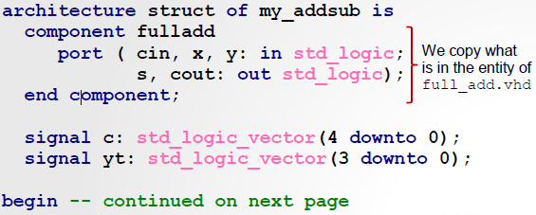
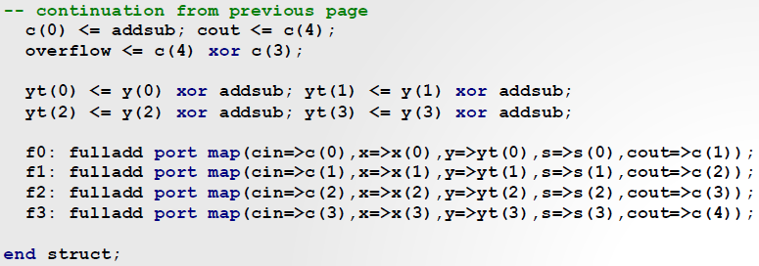
VHDL For FPGA
4-bit Adder/Subtracter (2’s Compliment)

Slide 41
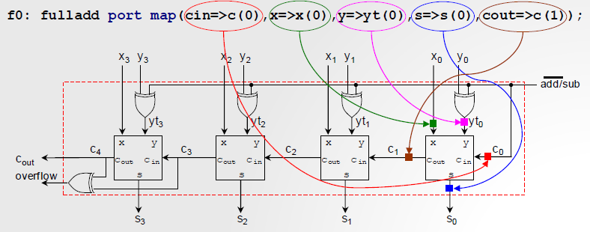
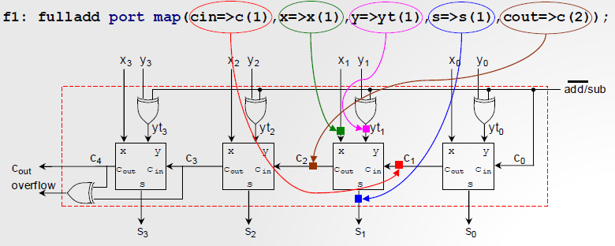
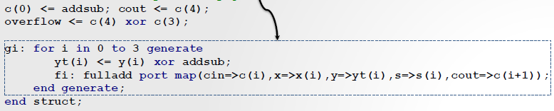
VHDL For FPGA
Use of ‘port map’ statement
Port map(signal in full adder => signal in top file, ...)
The ‘for generate’ statement
Instantiating components can be a repetitive task, thus the for-generate statement is of great help here:

Slide 42
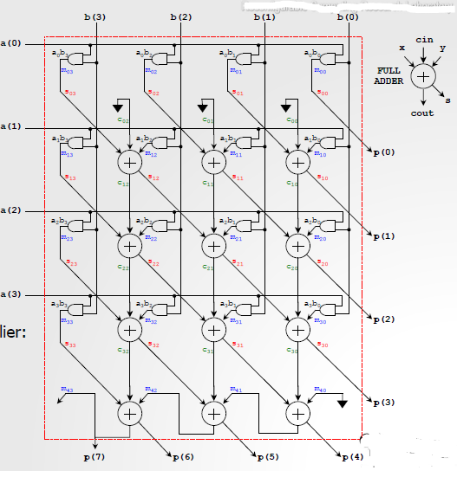
VHDL For FPGA
4-bit Array Multiplier (Introduction to Parametric Coding)
Interesting example of structural description. By connecting full adders and AND gates, we build this array multiplier.
We parameterize the circuit with ‘if-generate', 'for-generate’, and the use of arrays in VHDL.
Testbench: we use conv_std_logic_vector to specify input values

Slide 43


VHDL For FPGA
Arithmetic Logic Unit (ALU)
This circuit executes two types of operations: logic (or bit-wise) and arithmetic.
The arithmetic unit and the logic unit are described in different VHDL files.
The arithmetic unit relies heavily on the parametric adder/subtractor unit.
The VHDL code is parameterized so as to allow for two N-bit operands.
The ‘sel’ inputs selects the operation to be carried on (as per the table).

Slide 44

VHDL For FPGA
6-to-6 LUT
The LUT contents (64 bytes ) are specified as a set of 6 parameters. These 6 parameters are ‘generics’ in the VHDL code
Note that if the parameters are modified , we will get a different circuit that needs to be re-synthesized . In other words , the LUT contents are NOT inputs to the circuit

